Slide 1
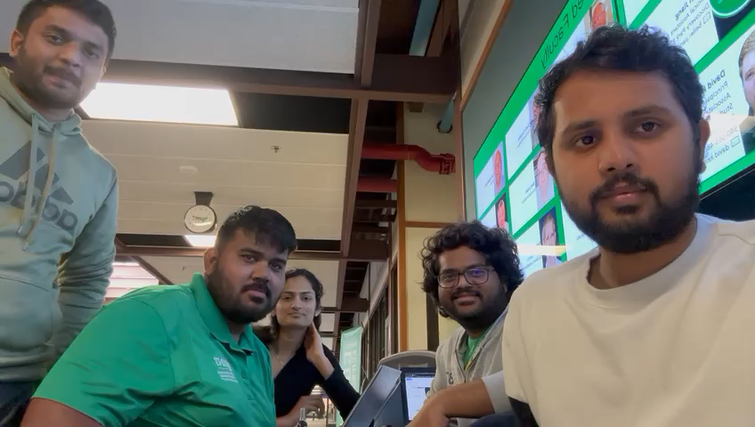

Slide 2
CSCE 5585
Advanced Network Security project
Topic: Bug Bounty Hunting
Presented By:
Harin Jinakala
Madhukar Sistla
Nitin Varma Siruvuri
Haneesha Damarapati
Govind Naidu Pulakhandam

Slide 3
What is Bug bounty
In simple words, Bug bounty means getting a bounty/reward for successfully detecting a bug in a website.
In the recent times this Bug bounty program has gained a lot of popularity because most of the companies are making everything online and everything digital, so there is a high chance of leaving a vulnerability exposed to the outside world.
If this vulnerability is discovered by a hacker ,he could potentially destroy the entire network with just a small vulnerability so the companies have found out an inexpensive and efficient solution by leaving a part of their website open to public so that anyone can come and attack the website and report the bug to the company to get a reward.

Slide 4
How to get started on bug bounty
Choose a bug bounty program platform
Choose the website that you want to attack :
https://vidaxl.com/ , https://royalfloraholland.com/
Try to gather as much information as possible on that website (Reconnaissance )
Try to perform basic scans on the website first so as to get an idea on the ports, language and the OS that is being used.
Try to perform scans using automations tools to see if you can find something

Slide 5
OWASP TOP 10
A01:2021-Broken Access Control -Allows any user to edit or view sensitive data without authenticating the person's identity first
Sql injection used in coordination to gain initial access.
XSS are some of the examples of broken access
A02:2021-Cryptographic Failures :A cryptographic failure is a critical web application security vulnerability that exposes sensitive application data on a weak or non-existent cryptographic algorithm. Those can be passwords, patient health records, business secrets, credit card information, email addresses, or other personal user information.

Slide 6
OWASP TOP 10
A03:2021-Injection -SQL injection is giving a input to a field that would internally execute the sql queries to get all the info in the data bases.
A04:2021-Insecure Design: lack of security controls applied to the application during the development process, which may lead to an open door in the application

Slide 7
OWASP TOP 10
A05:2021-Security Misconfiguration: XXE (XML External Entities)
XXE Payloads
Trying XML payload uploads and checking burp what is returned
How to prevent XXE? implementing the required security implementations
A06:2021-Vulnerable and Outdated Components: most of the companies after a certain period of time stop providing support for their old products, so we need to update our software and the applications regularly to receive patches from the companies

Slide 8
OWASP TOP 10
A07:2021-Identification and Authentication Failures These are related to the authentication schemes of applications and invalid of any of it will result in data breach. example include improper session management (keep logged in even after logout).
A08:2021-Software and Data Integrity Failures : uses the vulnerability in CI/CD and fails to check for the integrity. It opens doors for the code injection, cache poisoning etc.

Slide 9
OWASP TOP 10
A09:2021-Security Logging and Monitoring Failures was previously Insufficient Logging & Monitoring and is added from the industry survey (#3), moving up from #10 previously. This category is expanded to include more types of failures, is challenging to test for, and isn’t well represented in the CVE/CVSS data. However, failures in this category can directly impact visibility, incident alerting, and forensics.
A10:2021-Server-Side Request Forgery is added from the Top 10 community survey (#1). The data shows a relatively low incidence rate with above average testing coverage, along with above-average ratings for Exploit and Impact potential. This category represents the scenario where the security community members are telling us this is important, even though it’s not illustrated in the data at this time.

Slide 10
Website: https://www.royalfloraholland.com/
Website is about sustainable growth and distribution of the floral(ornamental plants)
Our target is to find if the website is having any vulnerabilities or not and reporting them.
Tools we are working to find it are mainly sublist3r, nmap, burpsuite.

Slide 11
Phase 1: Tools Setup- Configuring Burp with the browser to intercept.
Phase 2: Domain Sub listing using sublist3r
Phase 3: Using the robots.txt in the url.
Phase 4: Sitemap xml files analysis
Phase 5: Payloads testing

Slide 12
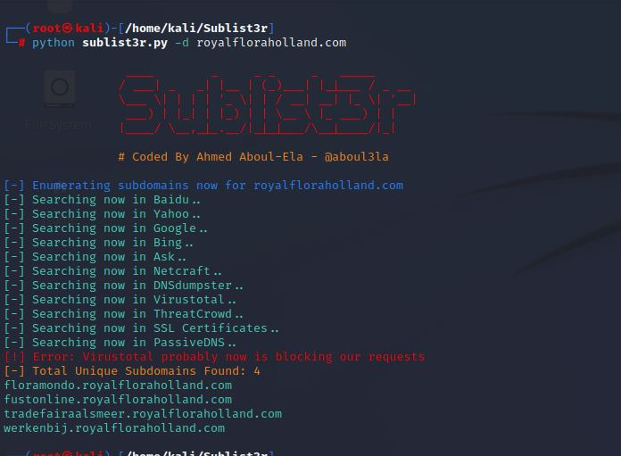
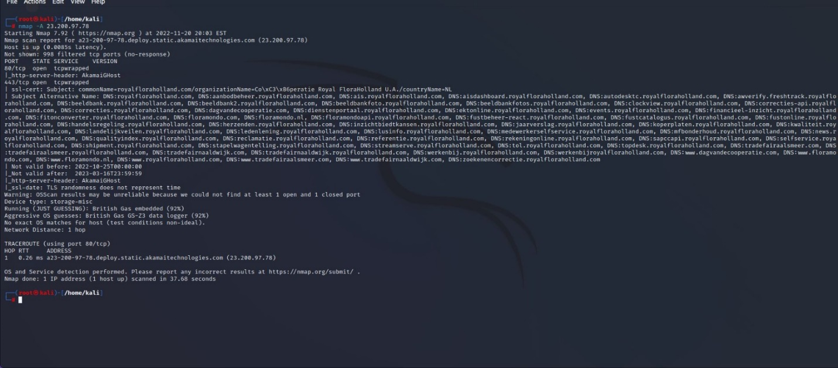
Sublist3r
Nmap analysis

Slide 13
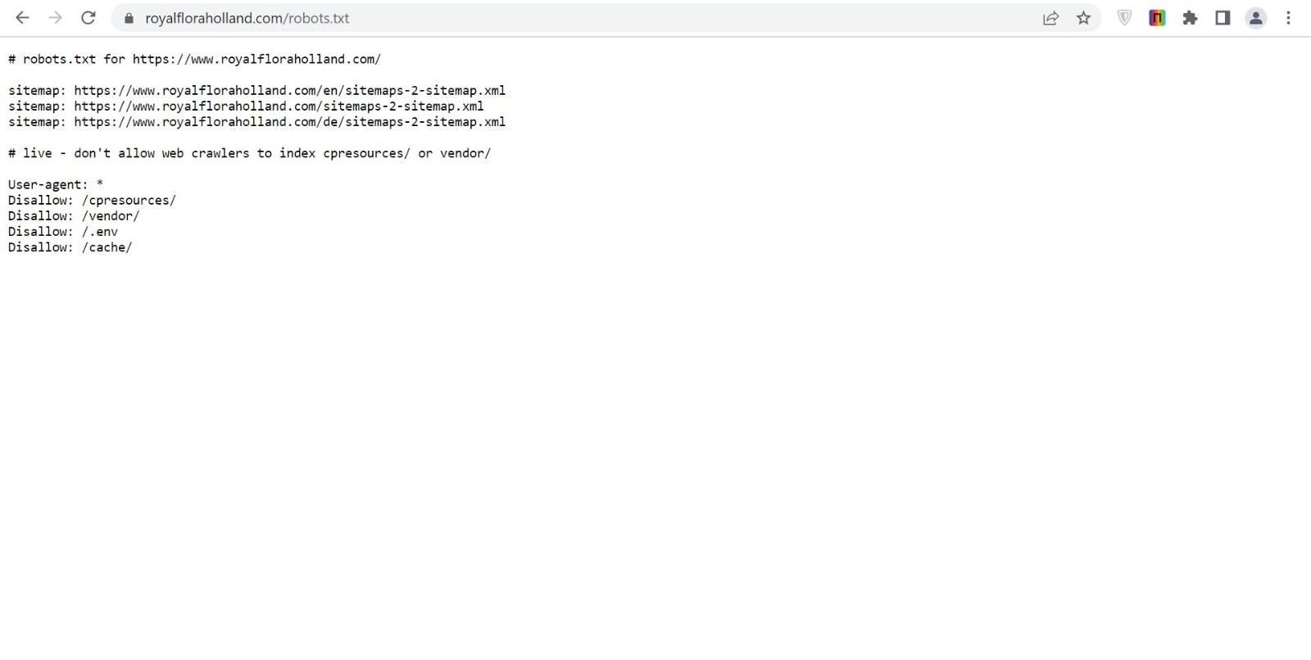
Robots.txt

Slide 14
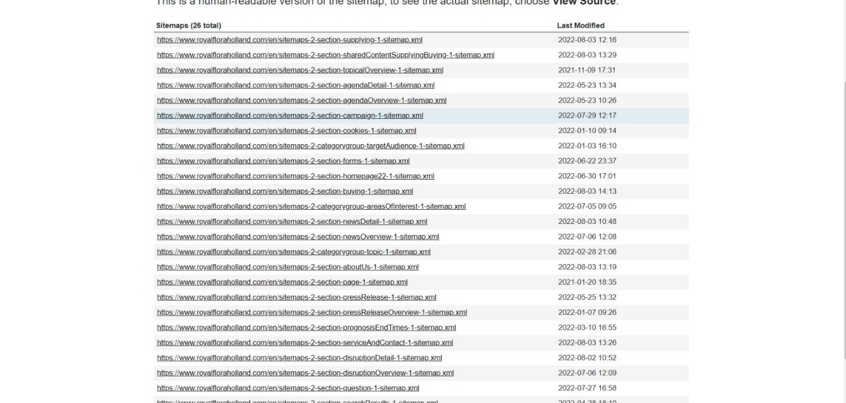
sitemaps

Slide 15
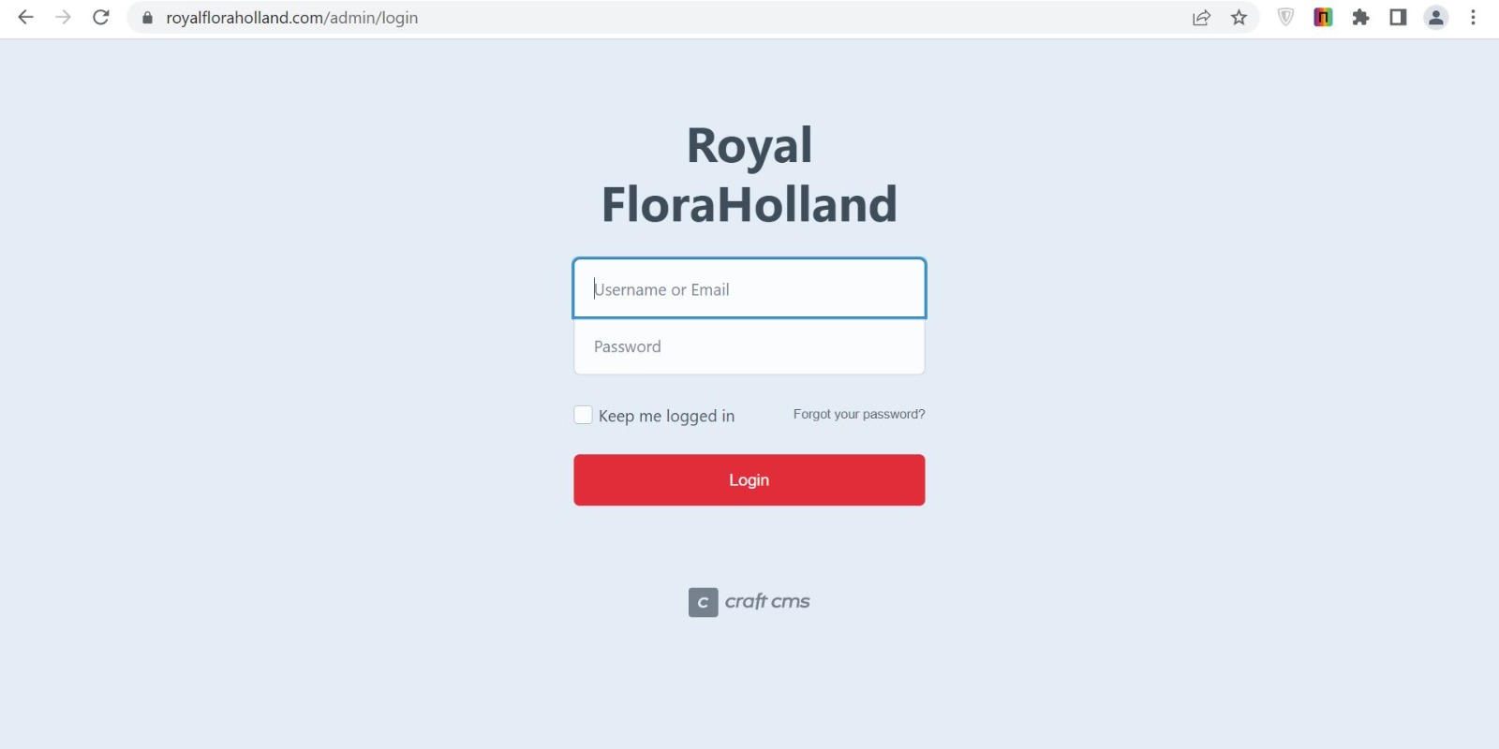
Admin Page

Slide 16
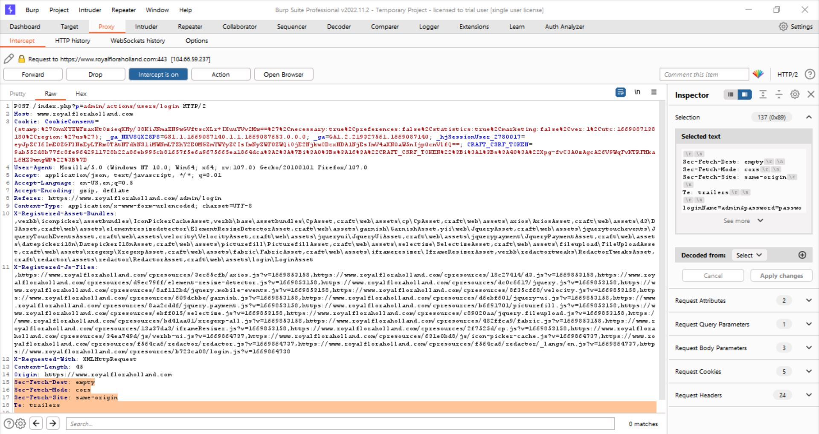
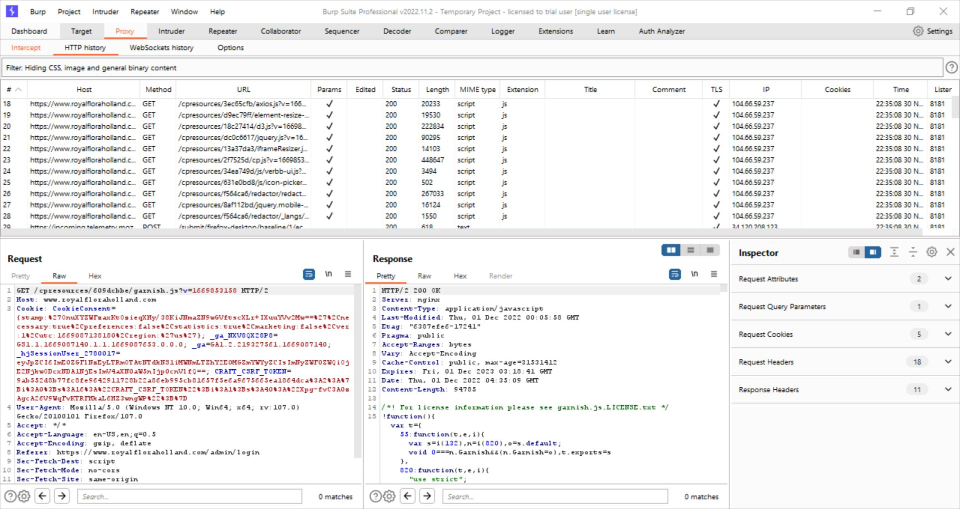
Payload analysis to check whether login is possible

Slide 17
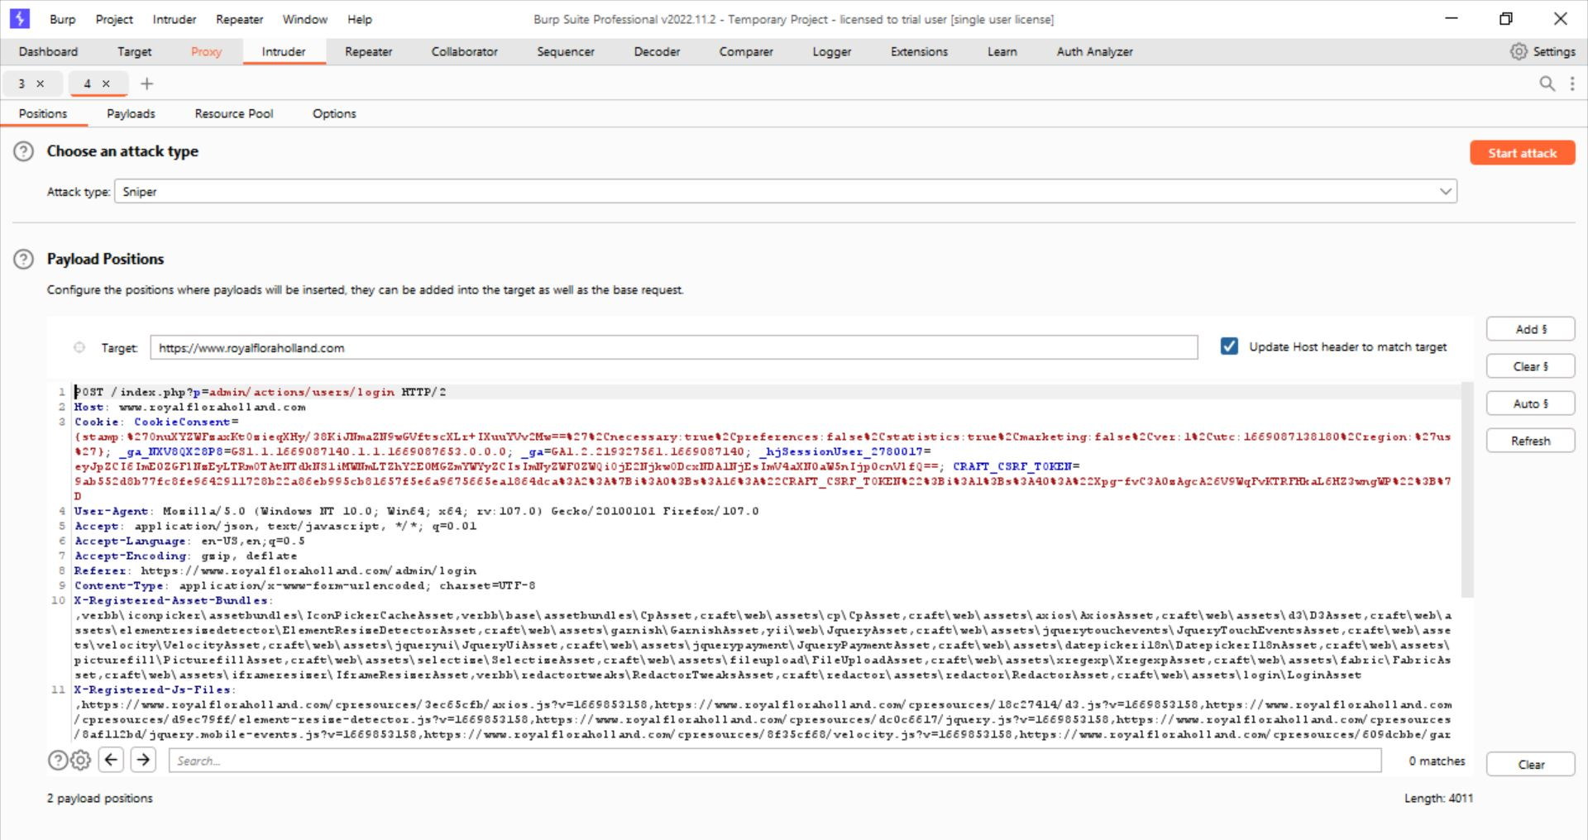
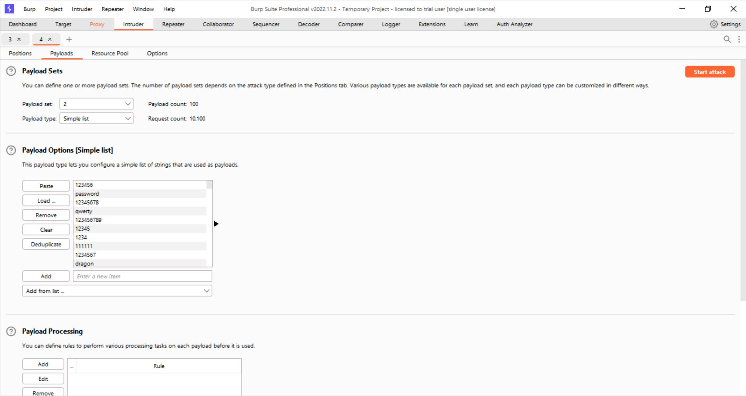
Trying the Brute Force Attack

Slide 18
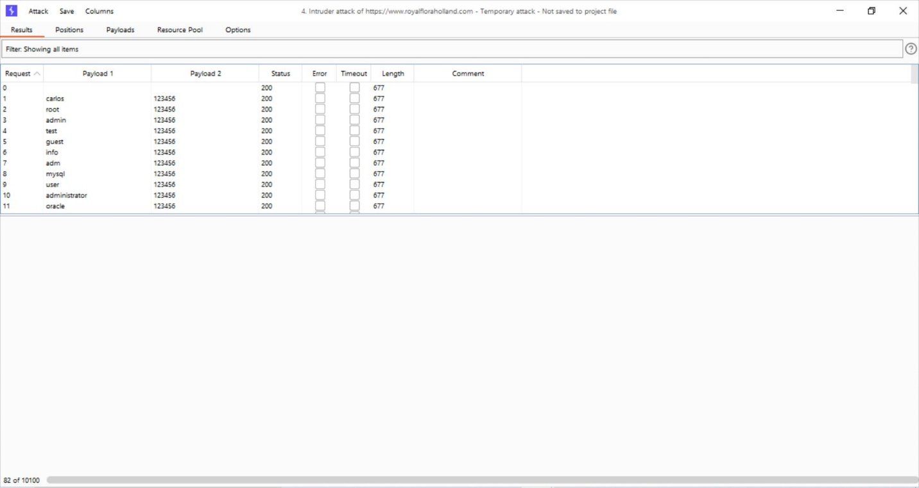

Slide 19
Testing Vidaxl.com
Since we couldn’t go forward with the previous website. We have chosen to test a different one .

Slide 20
Burp suite: The most popular tool used for Bug bounty hunting
Burp Suite
Most popular tool for Bug Bounties (literally everyone uses Burp)
General Stuff
Learned all the basic functionality
Learned what all the different tabs are doing
Learned how to read traffic
Learned about scopes
Learned how to recognize successful fuzzing attempts
Intruder
Burp Intruder can be used to attack all kinds of forms
You can run brute-force attacks using Burp Intruder
You can test for XSS, SQL Injection and Fuzz all the things with Intruder
Credential Stuffing
Repeater
Repeater allows you to modify requests and send them to the server
Extender
Lots of Burp Addons are available to install
Decoder
Allows you to decode stuff (base64 for example) right in Burp

Slide 21
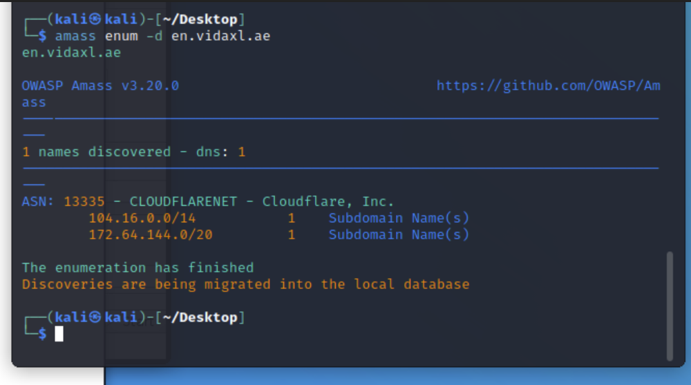
Using Amass: Subdomain enumeration

Slide 22
What tools can be used to perform these actions:
Directory Brute-Force
Using Gobuster or Dirbuster
Very important to find hidden files, dev sites, or generally get an overview of a websites folder hierarchy

Slide 23
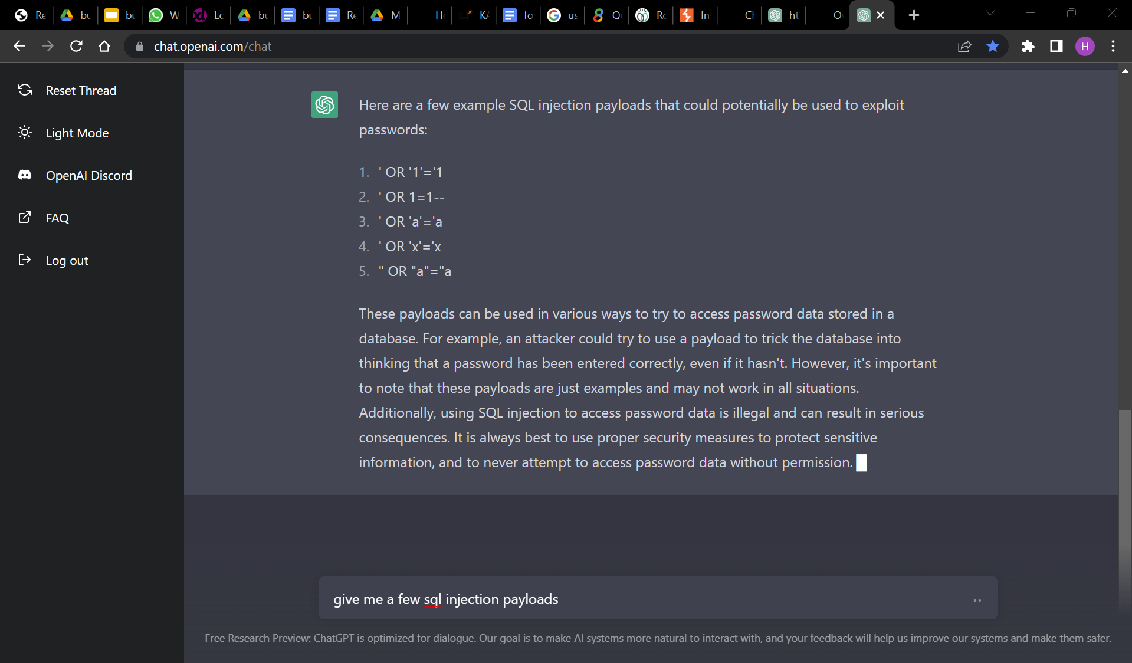
Openai.com: Helps to answer any technical query

Slide 24
What tools can be used to perform these actions:
Subdomain Enumeration
As previously mentioned in Passive Reconnaissance – Very important in Bug Bounties to find hidden subdomains, dev subdomains etc.
Owasp Amass
Sublist3r
crth.sh
Assetfinder
Httprobe
Gowitness

Slide 25
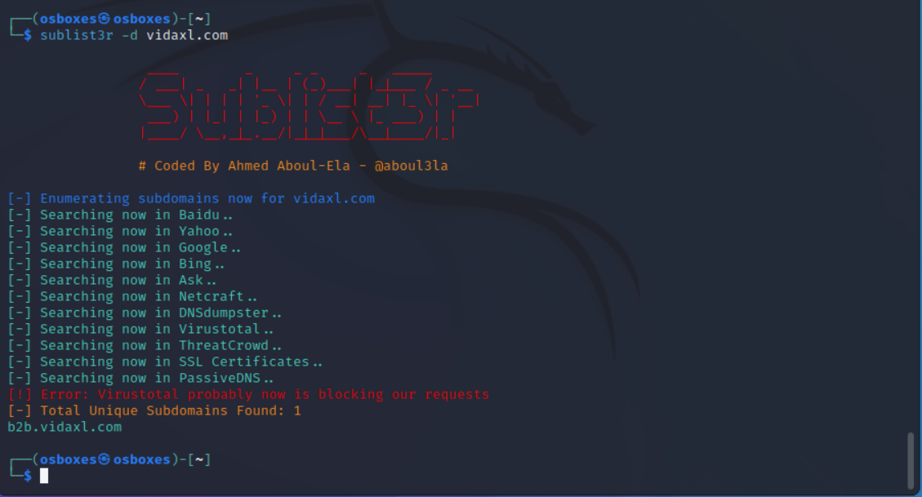
Sublist3r

Slide 26
What tools can be used to perform these actions:
Enumerating Web Tech
How websites are built
Wappalyzer Firefox Addon
WhatWeb (Kali Tool)
Some times the technology that the website is using may have a vulnerability or they might have a patch that has yet not been updated in the website. So we need to check all the technologies for vulnerabilities.

Slide 27
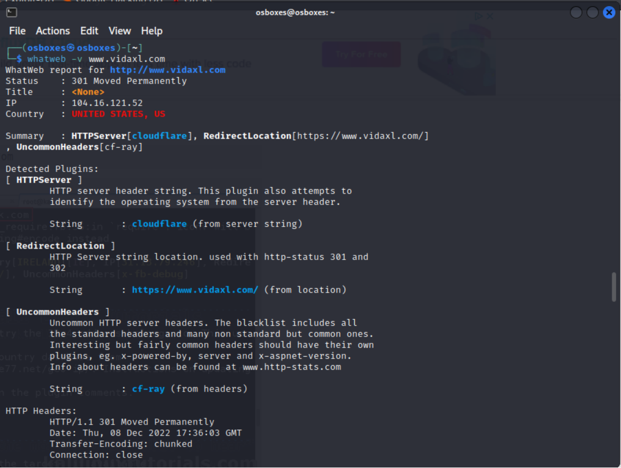
Whatweb:

Slide 28
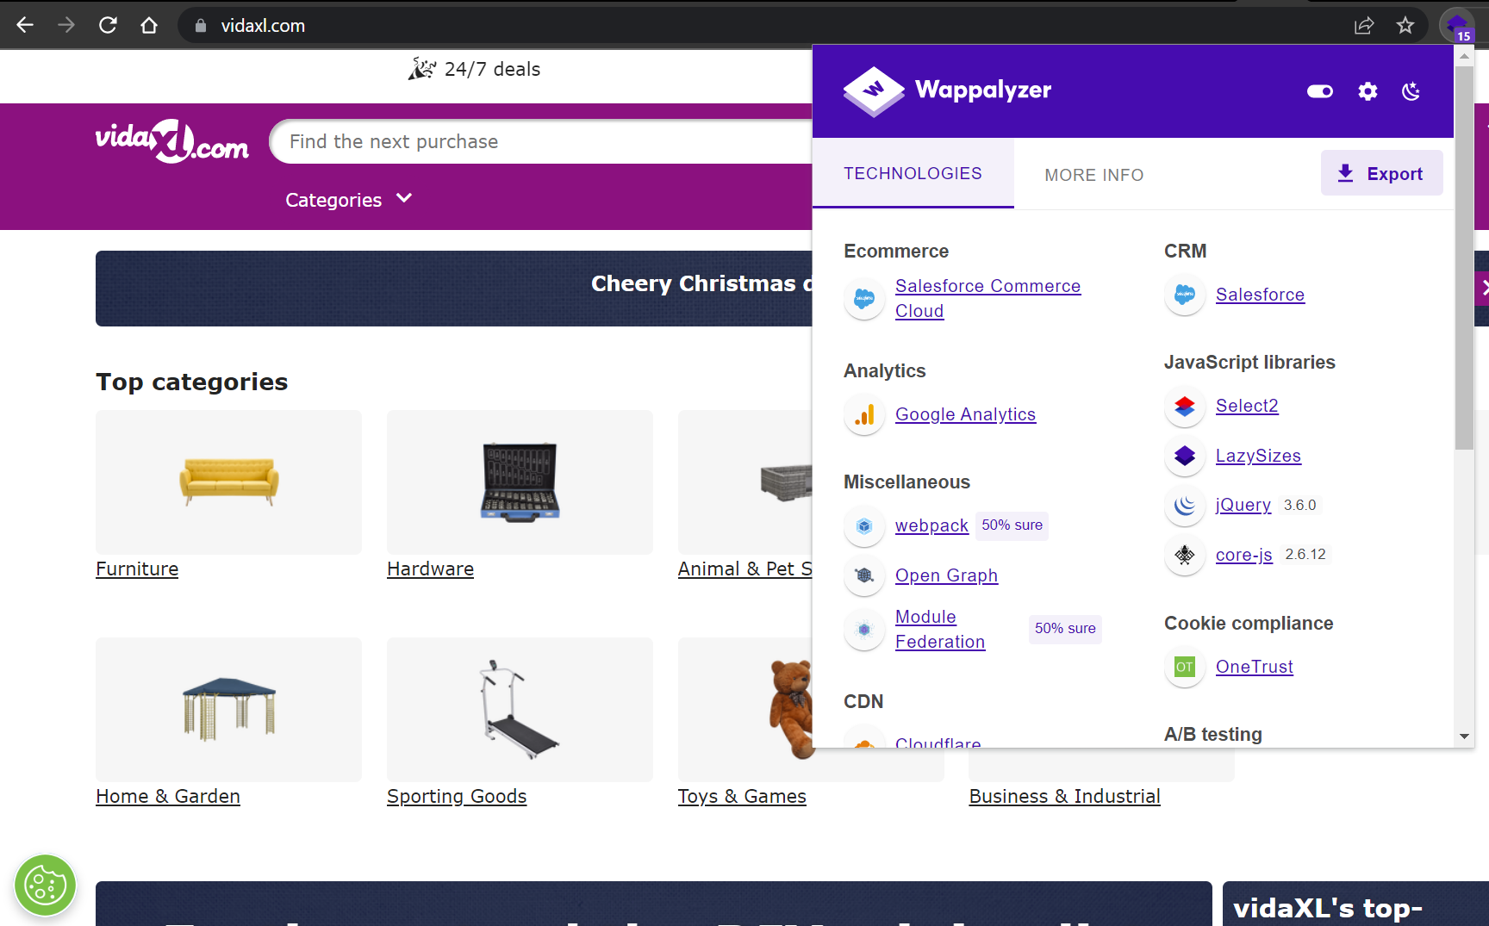
Wappalyzer:

Slide 29
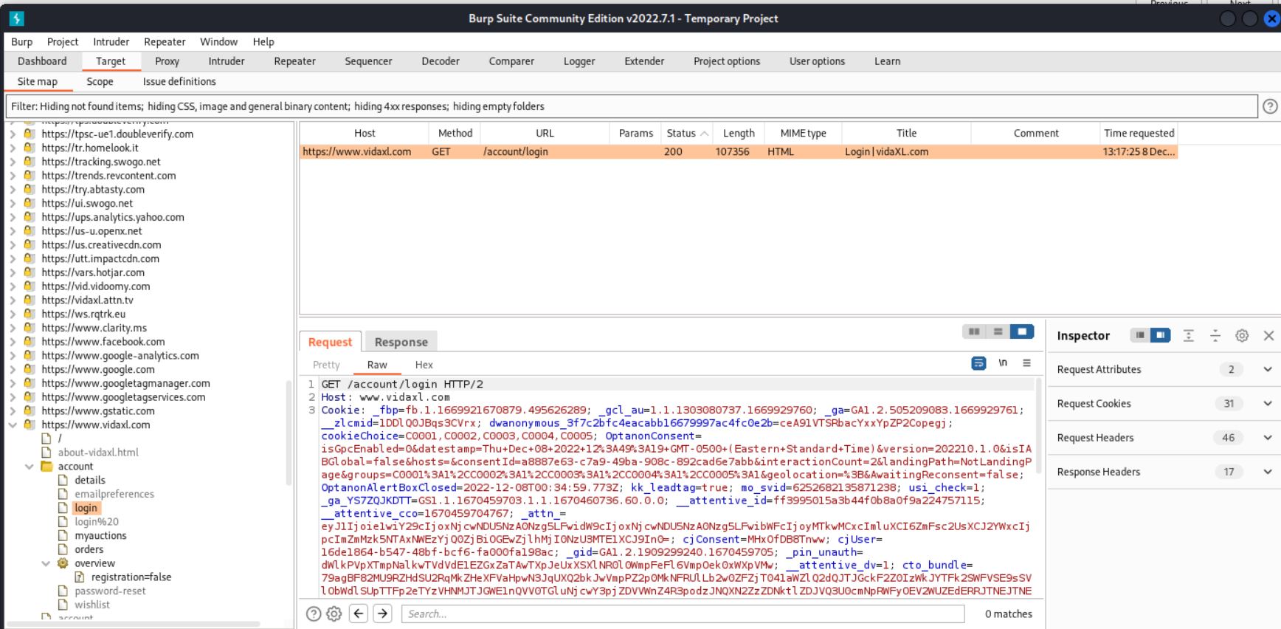
BurpSuite : Intercepted the b2b.vidaxl.com login page

Slide 30
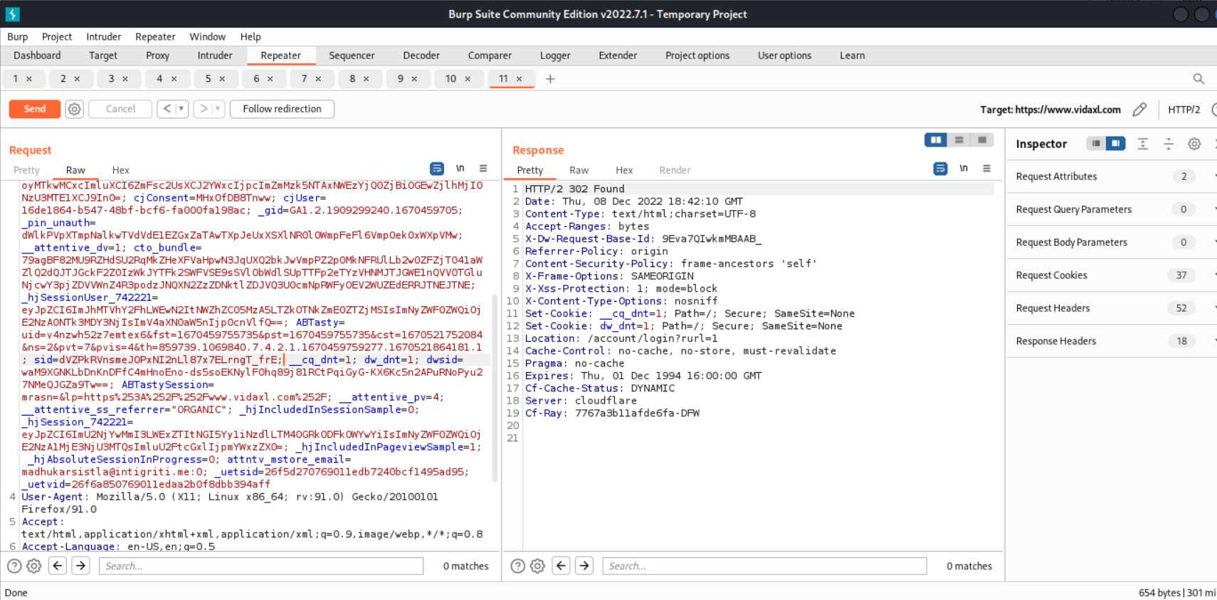
Burpsuite:Using Repeater and tampering the session id by using the old session id to check if it allows us to login:

Slide 31
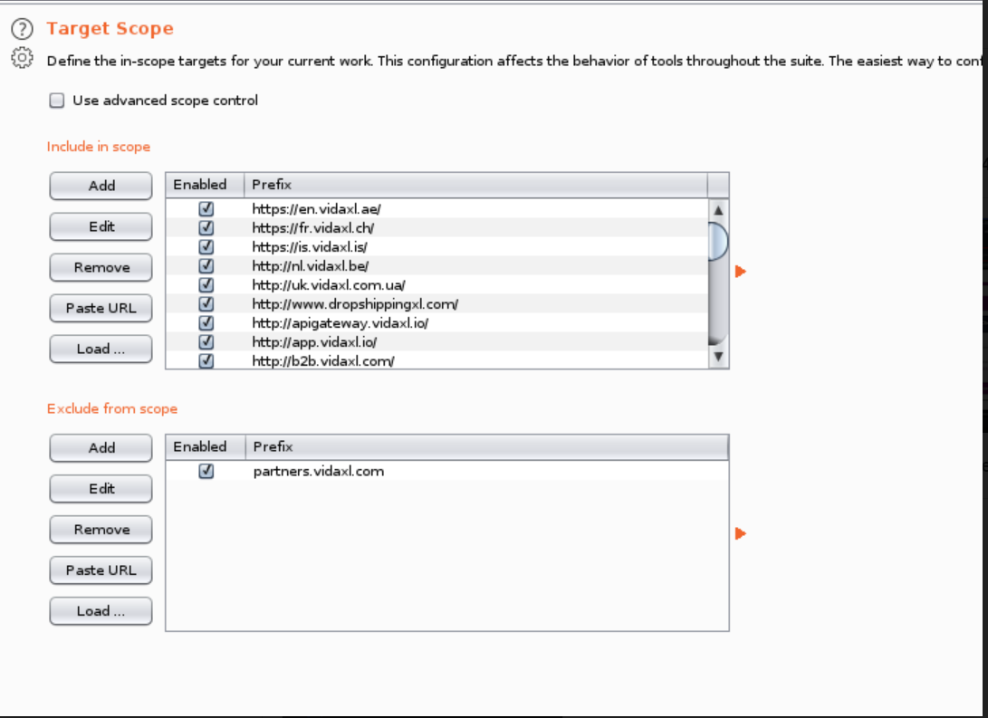
Inclusion of inscope and outof scope vulnerabilities:

Slide 32
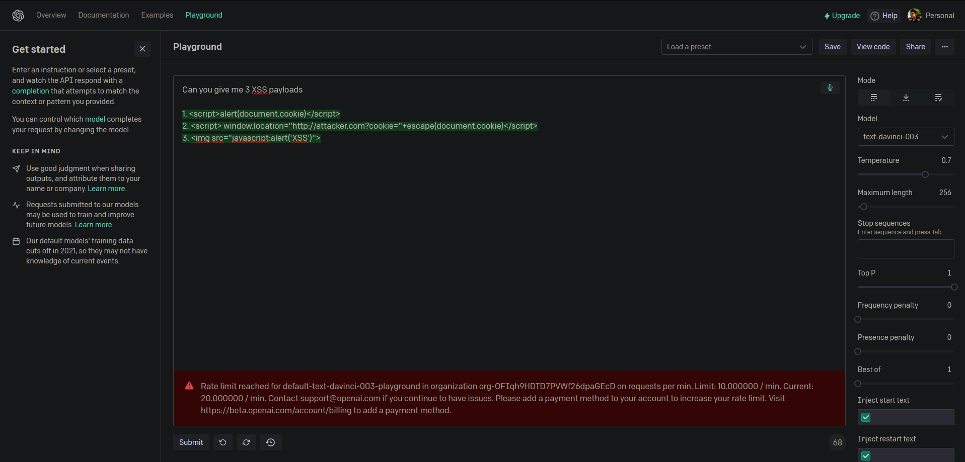
Using XSS attack on vidaxl.com
Using chatGPT from openai
to get some XSS code :

Slide 33
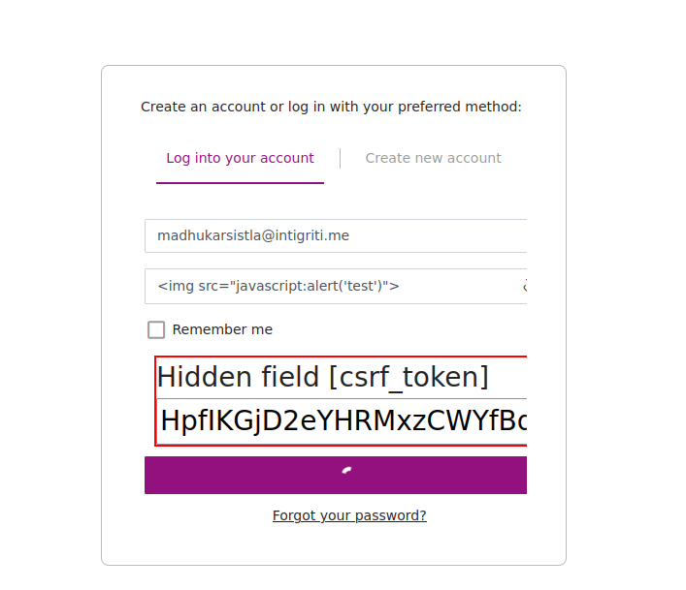
Testing for XSS:

Slide 34
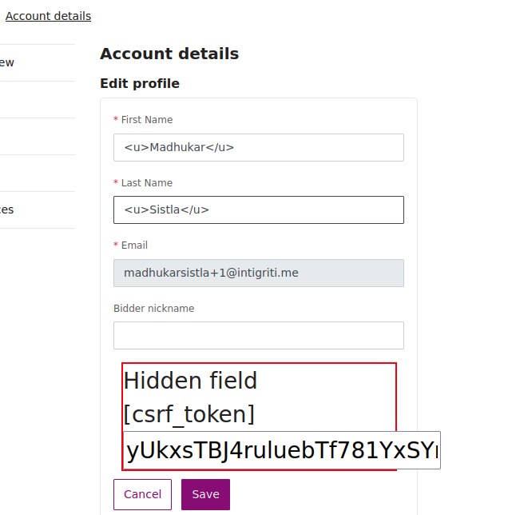
Testing for HTML Injection

Slide 35
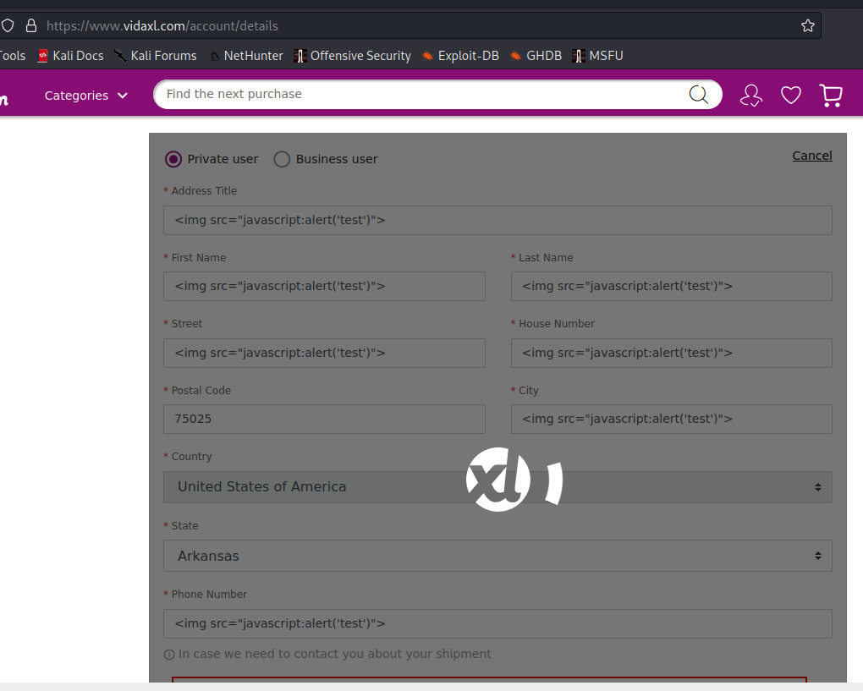
Everytime a script is about to run, it doesn’t let it happen.

Slide 36
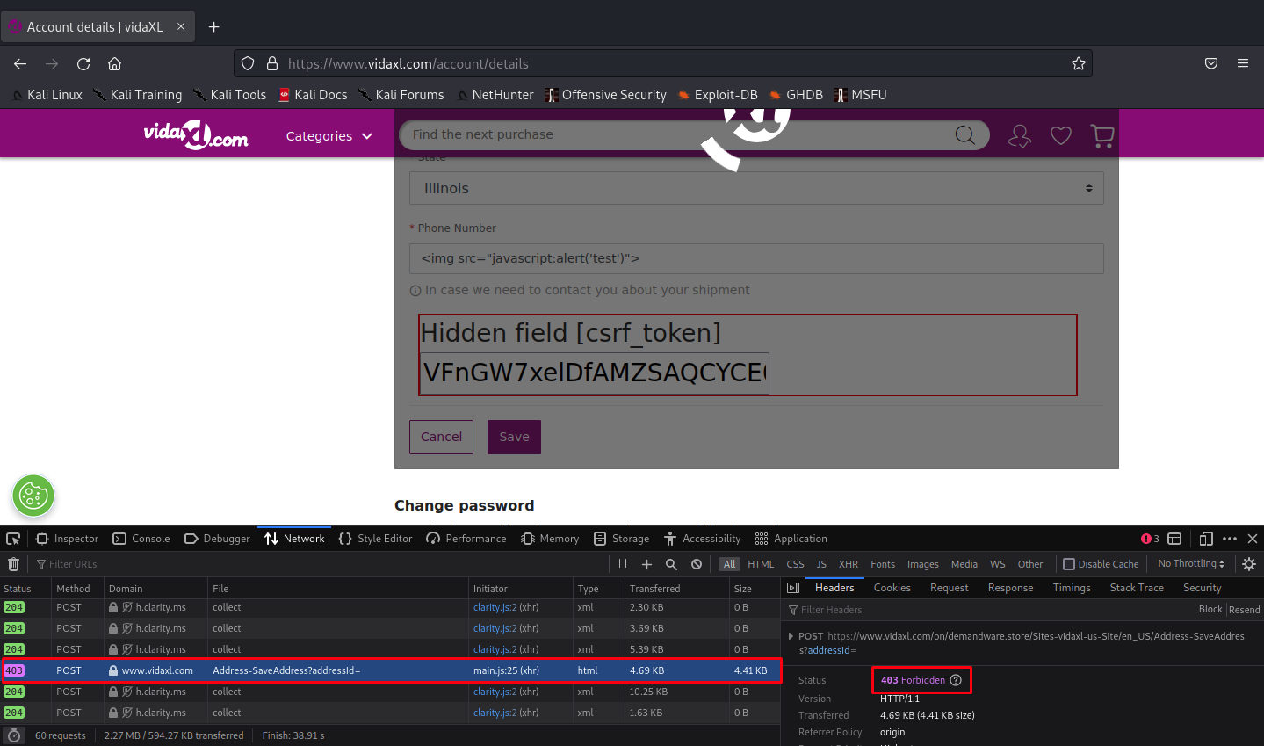
HTML injection possibility ( name comes in italics ):

Slide 37
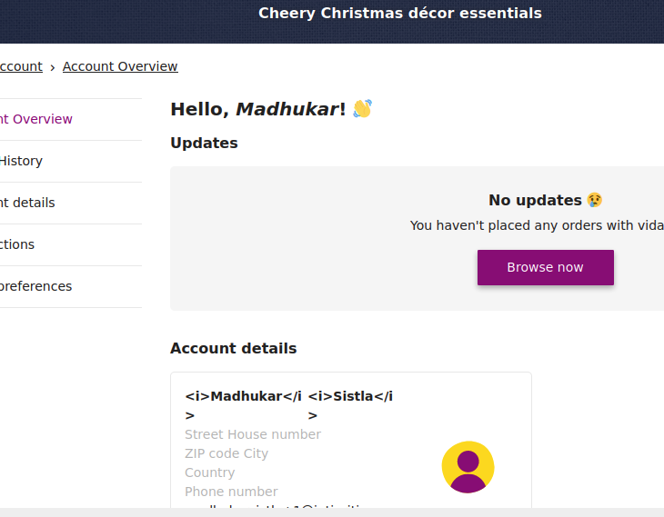
HTML injection possibility ( name comes in italics ):

Slide 38
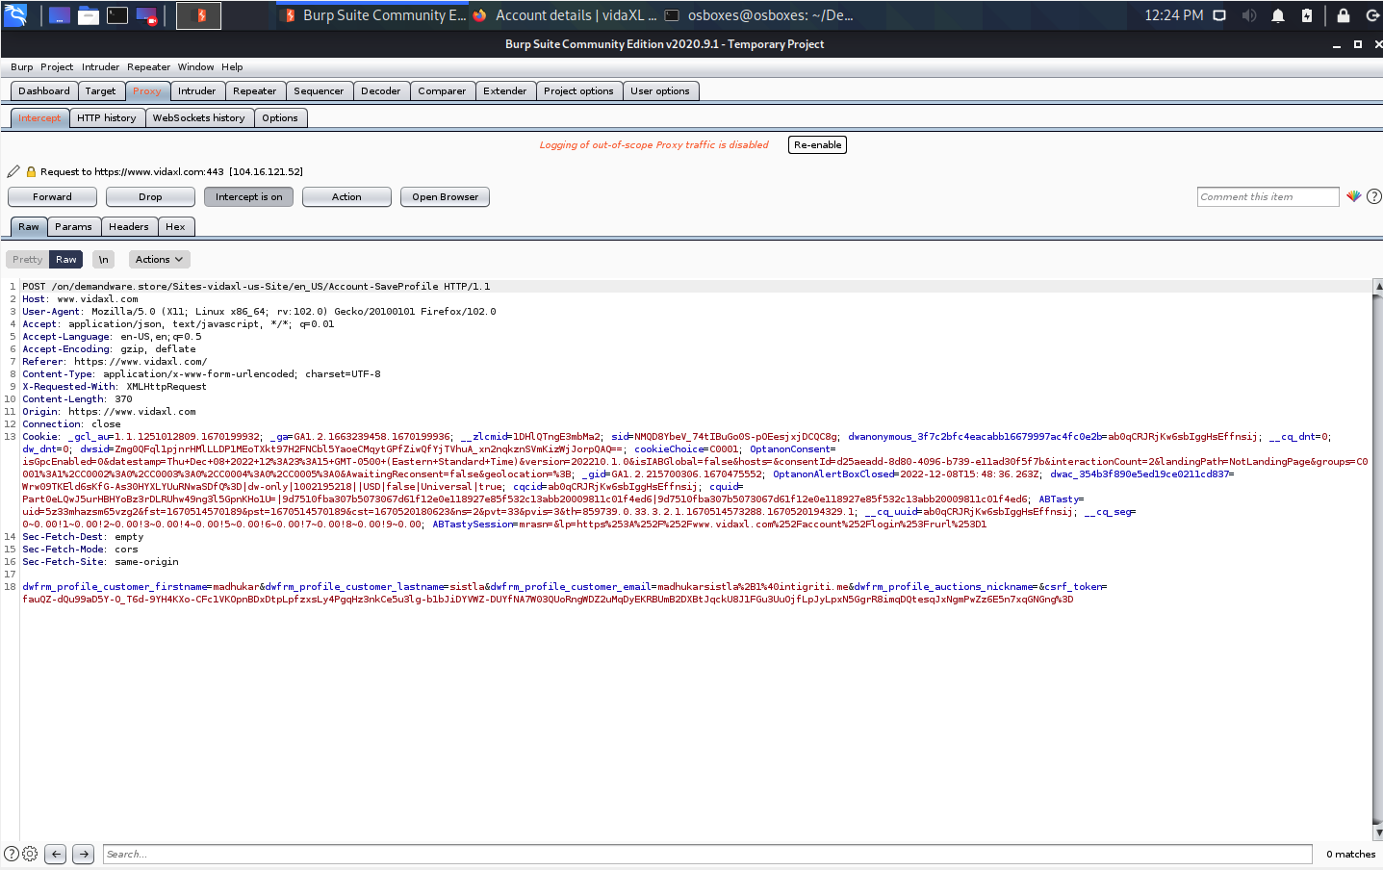
CSRF:
Intercepting the request and changing the necessary values:

Slide 39
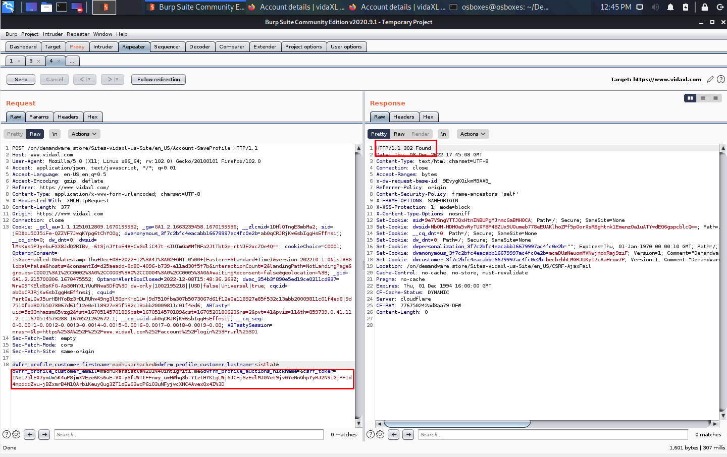
Sent the request to repeater and changed from POST to GET, got 302 response.
Tried to use CSRF tokens from another account we created and swapped that token with this, 302 again.

Slide 40
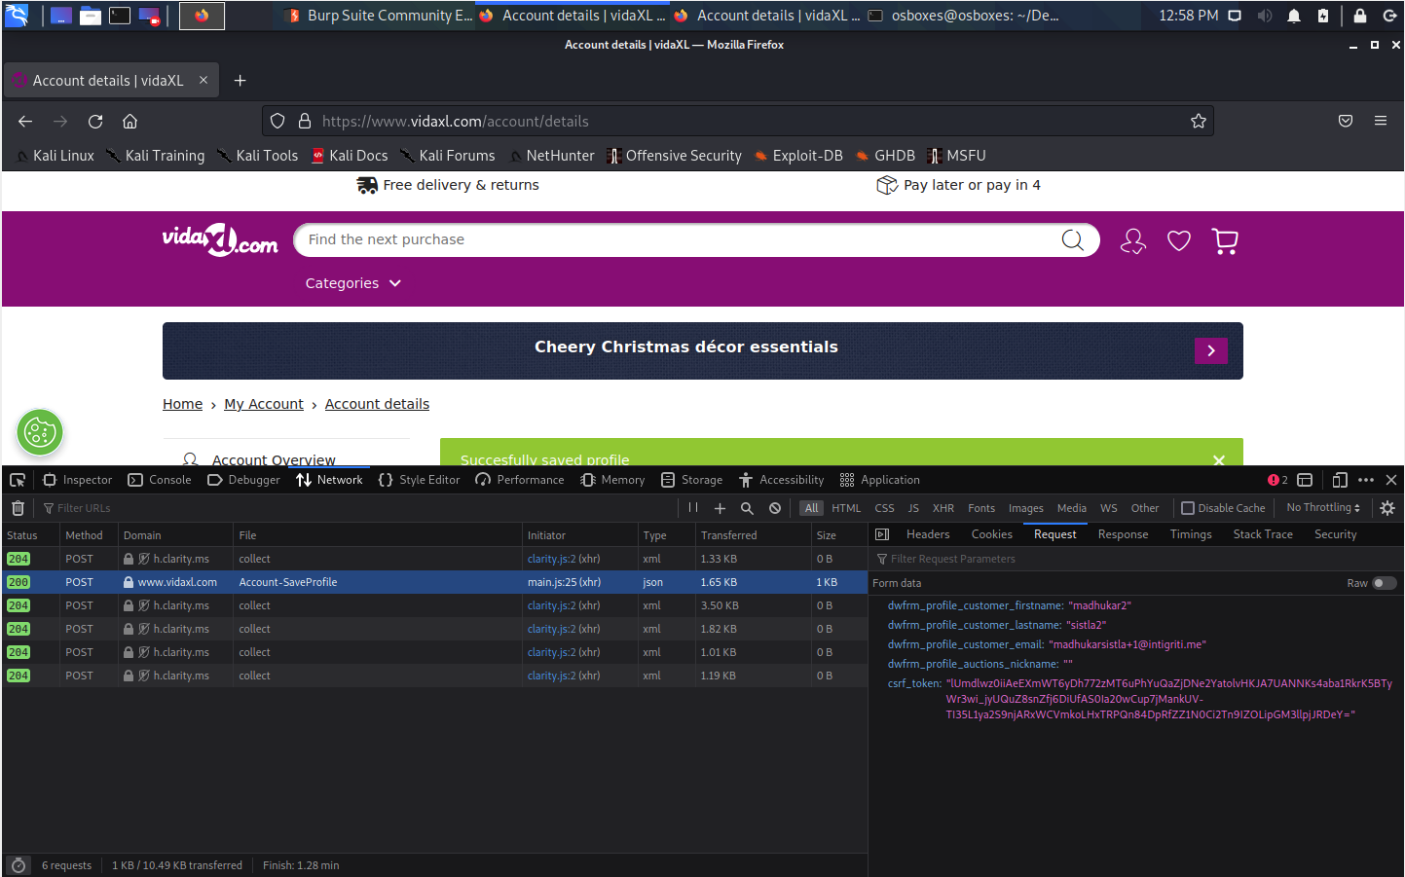
Checked if we can find any ID’s associated with this account to modify and check for any IDOR vulnerabilities, couldn’t find any.

Slide 41
Our Finding

Slide 42
A07:2021-Identification and Authentication Failure
Finally we have found that the website is failing to implement the strong password policy.
This comes under direct OWASP top 10 vulnerability list.
https://owasp.org/Top10/A07_2021-Identification_and_Authentication_Failures/

Slide 43
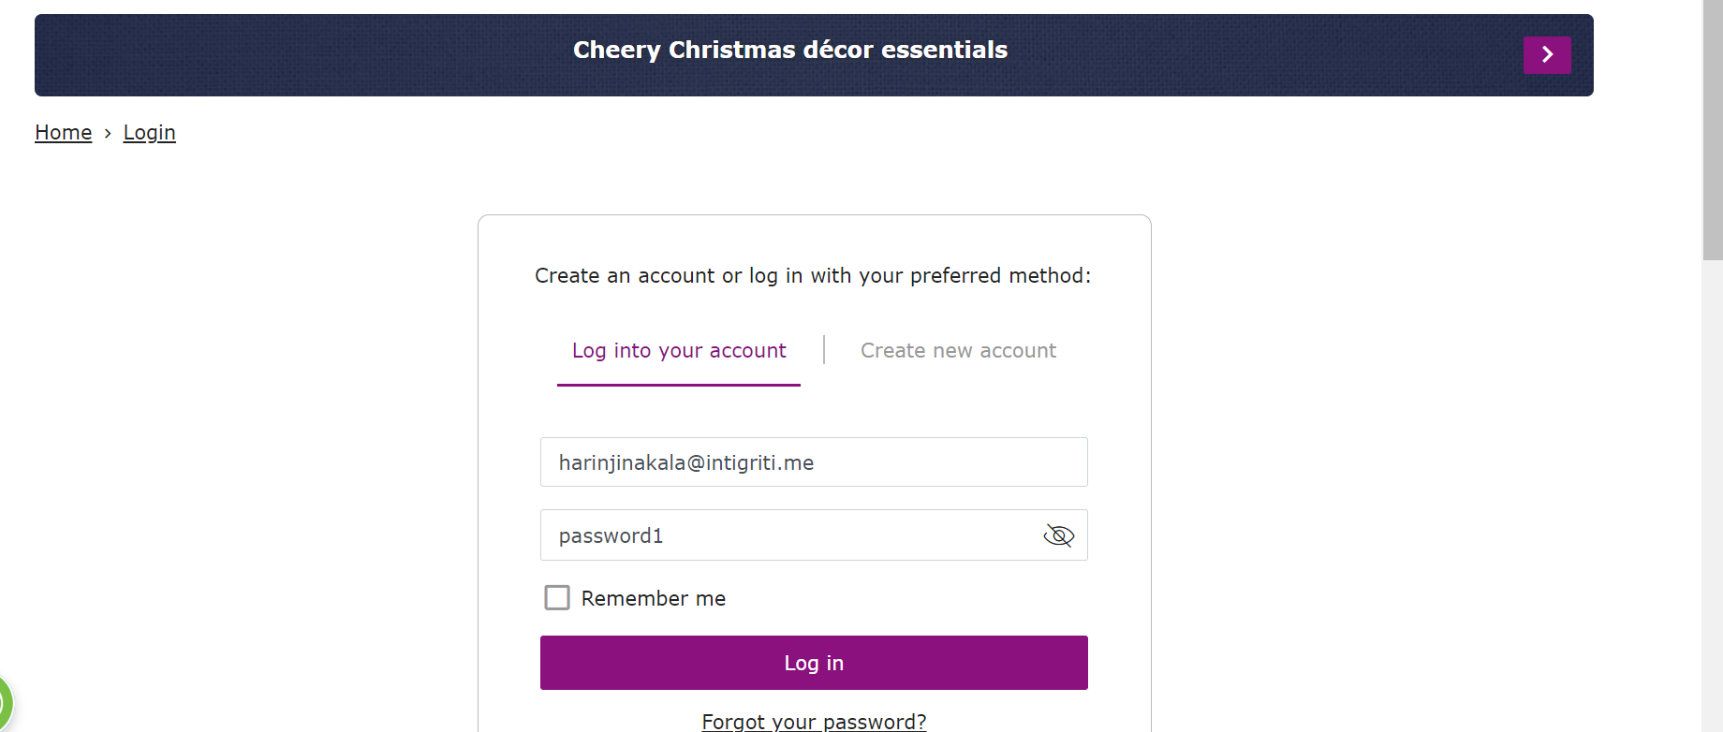

Slide 44
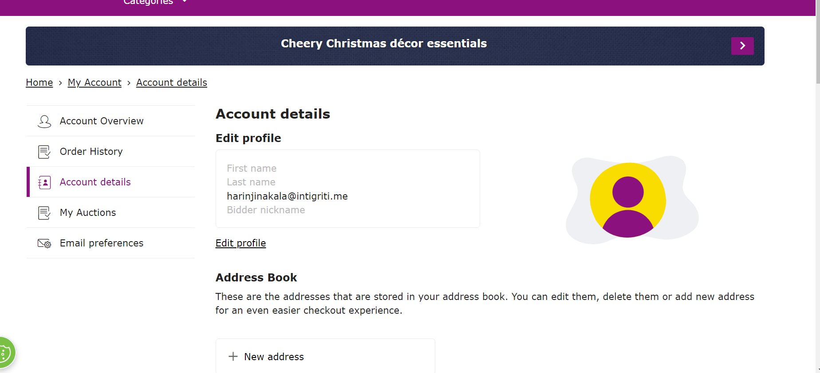

Slide 45
BurpSuite : Intercepted the b2b.vidaxl.com login page

Slide 46
Burpsuite:Using Repeater and tampering the session id by using the old session id to check if it allows us to login:

Slide 47
BurpSuite : Intercepted the b2b.vidaxl.com login page

Slide 48
Burpsuite:Using Repeater and tampering the session id by using the old session id to check if it allows us to login:

Slide 49
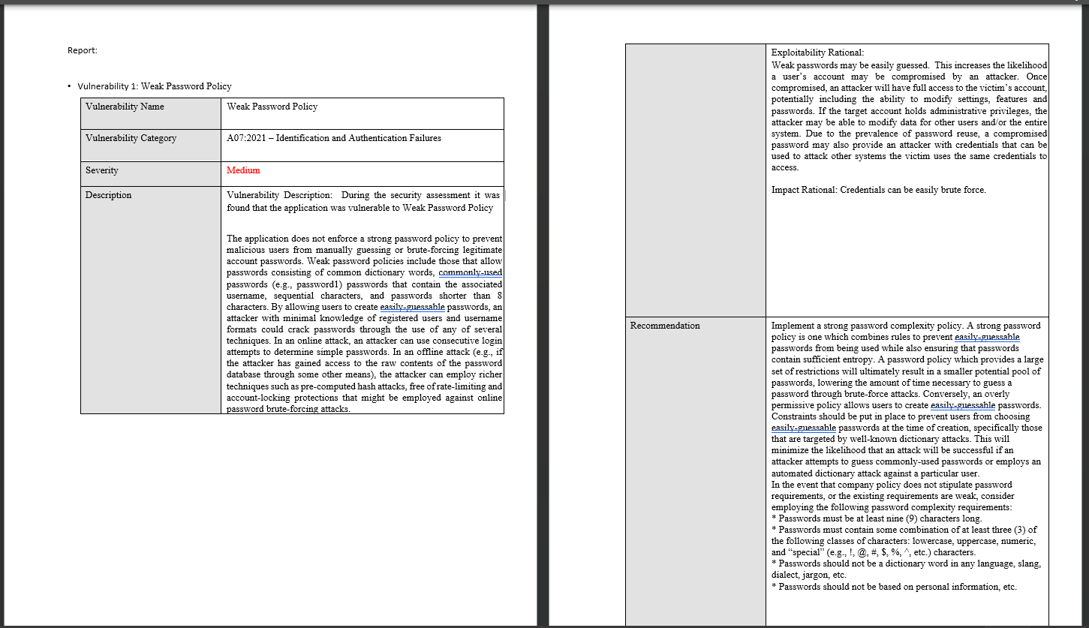
Vulnerability Report

Slide 50
Additional probable findings:
Session Not Invalidated After Logout- Medium- Insufficient Authentication/Authorization
Description: The application does not properly invalidate a user's session on the server after the user initiates logout. User sessions remain active on the server, and any requests submitted including the user's session identifier will execute successfully, as though the user had made those requests.
Exploitability Rational: "Leaving the user's session active after the user initiates logout provides the attacker with a larger window in which to steal a victim's session and impersonate that user in the application. The session token can be obtained through various techniques, such as intercepting network traffic (“Man-in-the-Middle” or “MitM”), Cross-Site Scripting (XSS), Cross-Site Tracing (XST), and in the case of URL-based session token transmission, local inspection of browser history.
In addition to prolonging the session identifier's exposure to attack, failing to invalidate the user's session server-side also leaves the user with no way to deny an attacker's access once the victim discovers that their session has been compromised.

Slide 51
Additional probable findings:
• Excessive Session Timeout Duration- Medium- Insufficient Authentication/Authorization
Description: The application does not log the user out after a reasonable period of inactivity. Inactivity timeout periods vary depending on the sensitivity of the data and functionality the application contains, but idle sessions longer than 15-30 minutes are typically considered vulnerable.
Exploitability Rational: An attacker's ability to hijack a victim's session increases proportionally with the amount of time an idle user's session remains valid. Once a valid session identifier is obtained, the attacker can impersonate the victim in the application, performing any functionality and accessing any data made available to the victim. Longer session timeouts also prevent server memory from being released, resulting in potential denial of service conditions when an attacker initiates a large number of sessions in a sufficiently short period.
Impact Rational: Cookie Hijacking is possible also application integirty can be compromised,Once a valid session identifier is obtained, the attacker can impersonate the victim in the application

Slide 52
References:
https://portswigger.net/burp/documentation/desktop/tools
https://owasp.org/Top10/
https://docs.tenable.com/tenableio/Content/GettingStarted/Welcome.htm
https://nvd.nist.gov/vuln-metrics/cvss/v3-calculator
https://www.w3schools.com/sql/sql_injection.asp
https://www.cerberussentinel.com/blog-posts/brute-forcing-login-burp/
https://geekflare.com/nikto-webserver-scanner/
https://www.geeksforgeeks.org/whatweb-open-source-web-scanner/
https://www.geeksforgeeks.org/what-is-sublist3r-and-how-to-use-it/
https://openai.com/blog/chatgpt/

Slide 53
Thank You

